Slide 1
Bhavani Thuraisingham
The University of Texas at Dallas
May – August 2024
Developing and Securing the Cloud, Edge and IoT
Lecture 2-5 (Module 2, Lecture #5)
Cloud Centric Assured Information Sharing and Analytics

Slide 2
Objective
This lecture will show how data can be shared in cloud securely using big data technologies.
It describes two secure query processing systems in the cloud with (i) relational data and (ii) semantic web data.
It also describes XACML and RDF-based Policy Engines in the Cloud
Aspects of securing the cloud including Identity Management, Secure Storage, and Monitoring as well as using the Cloud for scalability are also discussed.
Finally, the role of Machine Learning is discussed.

Slide 3
Assured Information Sharing Approach
Policy and Incentive-based Information Sharing
  Integrate the Medicaid claims data and mine the data;
  Enforce policies and determine how much information has been lost (Trustworthy partners);
  Determine incentives and risks for information sharing
Apply game theory and probing to extract information from semi-trustworthy partners
Conduct Active Defence and determine the actions of an untrustworthy partner
  Defend ourselves from our partners using data analytics techniques
  Conduct active defence – find our what our partners are doing by monitoring them so that we can defend our selves from dynamic situations

Slide 4
Types of Policies
Agency 1 wishes to share its resources if Agency 2 also shares its resources with it
Agency 1 asks Agency 2 for a justification of resource R2
Agency 1 shares a resource with Agency 2 provided Agency 2 does not share with Agency 3
Agency 1 shares a resource with Agency 2 depending on the content of the resource or until a certain time
Agency 1 shares a resource R with agency 2 provided Agency 2 does not infer sensitive data S from R (inference problem)
Agency 1 shares a resource with Agency 2 provided Agency 2 shares the resource only with those in its organizational (or social) network

Slide 5
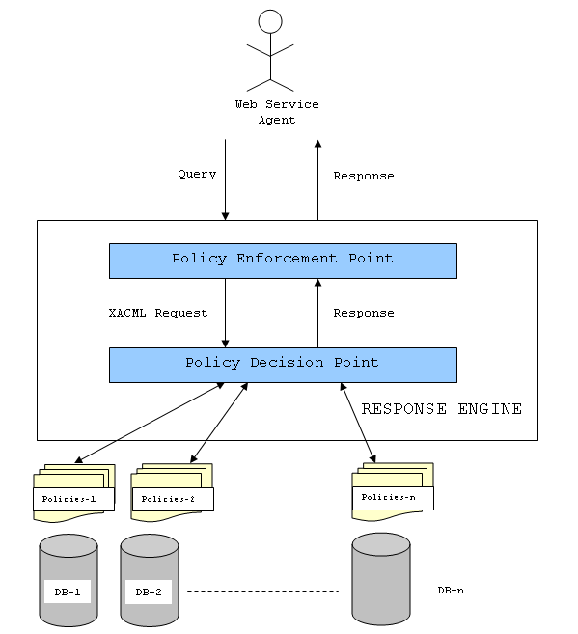
Policy Enforcement Prototype
Coalition

Slide 6
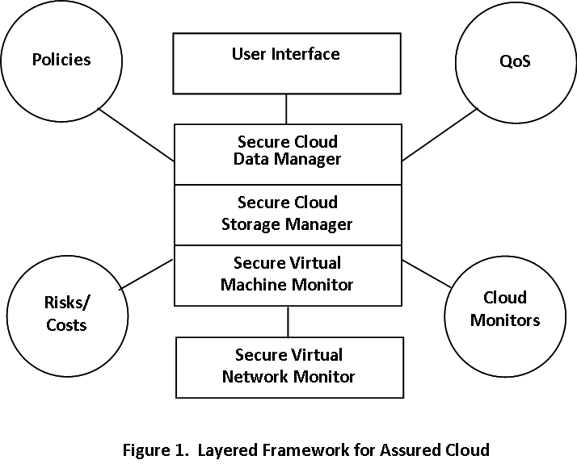
Layered Framework for Assured Cloud Computing
Policies
XACML
RDF
QoS
Resource
Allocation
Applications
HIVE/SPARQL/Query
Hadoop/MapReduc/Storage
Risks/
Costs
XEN/Linux/VMM
Cloud Monitors
Secure Virtual
Network Monitor
Figure2. Layered Framework for Assured Cloud

Slide 7

Secure Query Processing with Hadoop/MapReduce
We have studied clouds based on Hadoop
Query rewriting and optimization techniques designed and implemented for two types of data
(i) Relational data: Secure query processing with HIVE
(ii) RDF data: Secure query processing with SPARQL
Demonstrated with XACML policies
Joint demonstration with Kings College and University of Insubria
  First demo (2012-3): Each party submits their data and policies
  Our cloud will manage the data and policies
  Second demo (2013-4): Multiple clouds

Slide 8
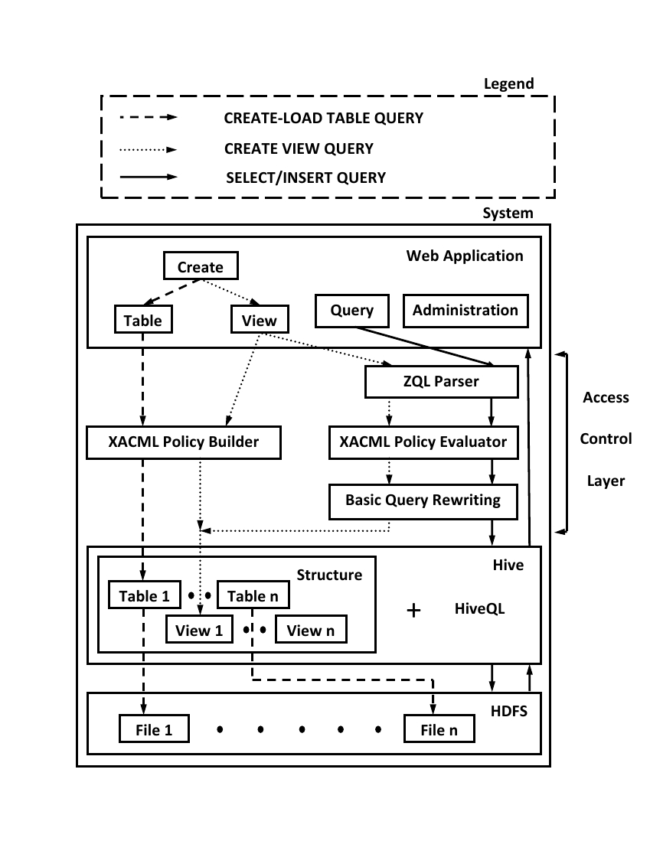
Fine-grained Access Control with Hive
System Architecture
Table/View definition and loading,
  Users can create tables as well as load data into tables. Further, they
  can also upload XACML policies for the table they are creating.
  Users can also create XACML policies for tables/views.
  Users can define views only if they have permissions for all tables specified in the query used to create the view. They can also either specify or create XACML policies for the views they are defining.
  CollaborateCom 2010

Slide 9
SPARQL Query Optimizer for Secure RDF Data Processing
Web Interface
To build an efficient storage mechanism using Hadoop for large amounts of data (e.g. a billion triples); build an efficient query mechanism for data stored in Hadoop; Integrate with Jena
Developed a query optimizer and query rewriting techniques for RDF Data with XACML policies and implemented on top of JENA
IEEE Transactions on Knowledge and Data Engineering, 2011
New Data
Query
Answer
Server
Backend
Data Preprocessor
MapReduce Framework
Parser
N-Triples Converter
Query Validator & Rewriter
Prefix Generator
XACML PDP
Predicate Based Splitter
Query Rewriter By Policy
Plan Generator
Predicate Object Based Splitter
Plan Executor

Slide 10
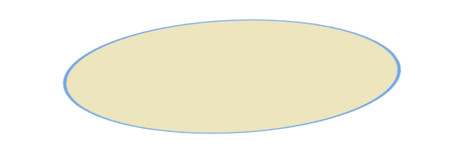
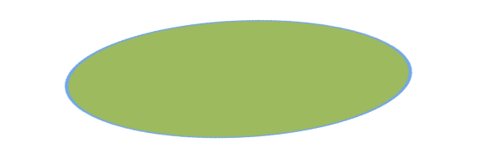
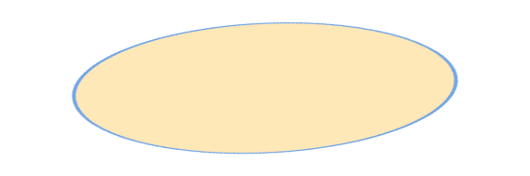




Demonstration: Concept of Operation
Agency 1
Agency 2
Agency n
…
User Interface Layer
Relational Data
RDF Data
Fine-grained Access Control with Hive
SPARQL Query Optimizer for Secure RDF Data Processing

Slide 11
RDF-Based Policy Engine
Technology
By UTDallas
Interface to the Semantic Web
Inference Engine/
Rules Processor
e.g., Pellet
Policies
Ontologies
Rules
In RDF
JENA RDF Engine
RDF Documents

Slide 12
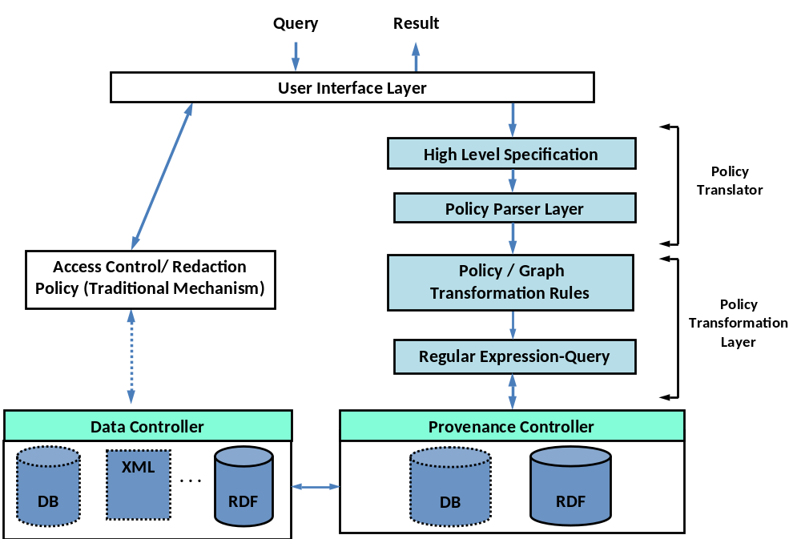
RDF-based Policy Engine on the Cloud
Determine how access is granted to a resource as well as how a document is shared
User specify policy: e.g., Access Control, Redaction, Released Policy
Parse a high-level policy to a low-level representation
Support Graph operations and visualization. Policy executed as graph operations
Execute policies as SPARQL queries over large RDF graphs on Hadoop
Support for policies over Traditional data and its provenance
IFIP Data and Applications Security, 2010, ACM SACMAT 2011
A testbed for evaluating different policy sets over different data representation. Also supporting provenance as directed graph and viewing policy outcomes graphically

Slide 13
Integration with
Assured Information Sharing:
Agency 1
Agency 2
Agency n
…
User Interface Layer
SPARQL Query
RDF Data
and Policies
Policy Translation and Transformation Layer
RDF Data Preprocessor
MapReduce Framework for Query Processing
Hadoop HDFS
Result

Slide 14
Some Other Related Topics
Secure Storage
Cloud Monitoring/Forensics
Identity Management in the cloud
Scalability
Role of Machine Learning
Note: We have also developed techniques to secure Hadoop and MapReduce. These techniques are taught as part of our Big Data Security and Privacy course at the University of Texas at Dallas.

Slide 15
Secure Storage and Query Processing in a Hybrid Cloud
The use of hybrid clouds is an emerging trend in cloud computing
  Ability to exploit public resources for high throughput
  Yet, better able to control costs and data privacy
Several key challenges
  Data Design: how to store data in a hybrid cloud?
    Solution must account for data representation used (unencrypted/encrypted), public cloud monetary costs and query workload characteristics
  Query Processing: how to execute a query over a hybrid cloud?
    Solution must provide query rewrite rules that ensure the correctness of a generated query plan over the hybrid cloud

Slide 16












Hypervisor integrity and forensics in the Cloud
Applications
Linux
Solaris
XP
MacOS
OS
integrity
forensics
Virtualization Layer (Xen, vSphere)
Hypervisor
Cloud integrity &
forensics
Hardware Layer
Secure control flow of hypervisor code
  Integrity via in-lined reference monitor
Forensics data extraction in the cloud
  Multiple VMs
  De-mapping (isolate) each VM memory from physical memory
Notes:
Another research problem we are working on is to address the “hypervisor integrity and forensic issues in the cloud”.
More specifically, we don’t want to a malicious VM to compromise other VMs, so we need to ensure the integrity of the hypervisors.
Our approach is to instrument hypervisor code, and verify the integrity at run-time (like Kevin’s in-lin reference monitor)
The other problem we are dealing with is how to extract the forensic data when one VM gets compromised.
The challenge is there are multiple VMs in a cloud, we have to isolate each VM memory from the physical memory. Currently, we are developing techniques to handle this problem.

Slide 17
Identity Management
Considerations in a Cloud
Trust model that handles
  (i) Various trust relationships, (ii) access control policies based on roles and attributes, iii) real-time provisioning, (iv) authorization, and (v) auditing and accountability.
Several technologies are being examined to develop the trust model
  Service-oriented technologies; standards such as SAML and XACML; and identity management technologies such as OpenID.
Does one size fit all?
  Can we develop a trust model that will be applicable to all types of clouds such as private clouds, public clouds and hybrid clouds Identity architecture has to be integrated into the cloud architecture.

Slide 18
Cloud/Big Data for Malware Detection
(Security as a Service)
Binary feature extraction involves
  Enumerating binary n-grams from the binaries and selecting the best n-grams based on information gain
  For a training data with 3,500 executables, number of distinct 6-grams can exceed 200 millions
  In a single machine, this may take hours, depending on available computing resources – not acceptable for training from a stream of binaries
  We use Cloud to overcome this bottleneck
A Cloud Map-reduce framework is used
  to extract and select features from each chunk
  A 10-node cloud cluster is 10 times faster than a single node
  Very effective in a dynamic framework, where malware characteristics change rapidly
Stream of known malware or benign executables
Buffer
Feature extraction and selection using Cloud
Training & Model update
Ensemble of Classification models
Unknown executable
Feature extraction
Classify
Class
Benign
Malware
Remove
Keep

Slide 19
Integrating Cloud Computing and Machine Learning
Machine Learning algorithms are computationally intensive (e.g., training including feature selection and testing); Cloud is a valuable tool for hosting the machine learning algorithms
We have shown how cloud is used to speed up machine learning for cyber security applications (e.g., malware detection in Lecture 2-4)
The cloud has to be secure to host any application – that is secure Hadoop, MapReduce, Query etc.
Note that the data is stored in the cloud (to provide data as a service); this data is essentially big data.
There is a need to apply machine learning for such big data to extract the useful nuggets; this area is also known as Cloud data analytics.
Also, Machine Learning could be applied to analyze the data to be shared as well as develop appropriate policies.

Slide 20
Directions
Cloud Computing and Web Services Provide the Infrastructure for Scalable Big Data Security and Privacy
This infrastructure can be used host many Big Data Security and Privacy Applications
Applications include:
  Privacy-Aware and Policy-Based Data Management Framework for Quantified Self
  Internet of Things
  Social Networks
  Geospatial Data Management
  Science and Engineering Applications
Integration of Cloud Computing and Machine Learning is essential for many applications including for security applications.
Cloud can be used for Security Applications; but the Cloud must be Secure (i.e. Security as a Service vs Secure Cloud)

